Slide 1
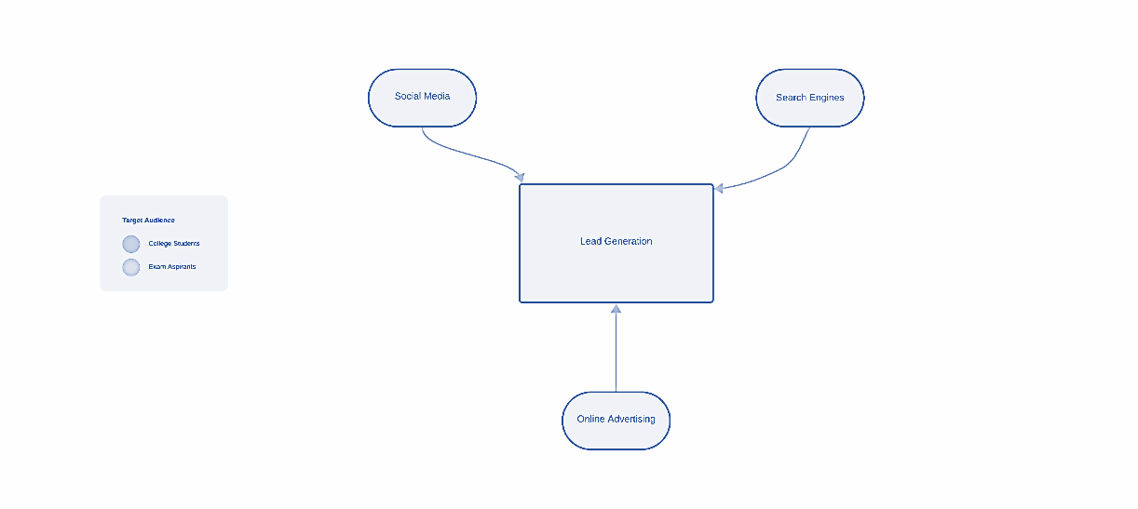
Lead Generation

Slide 2
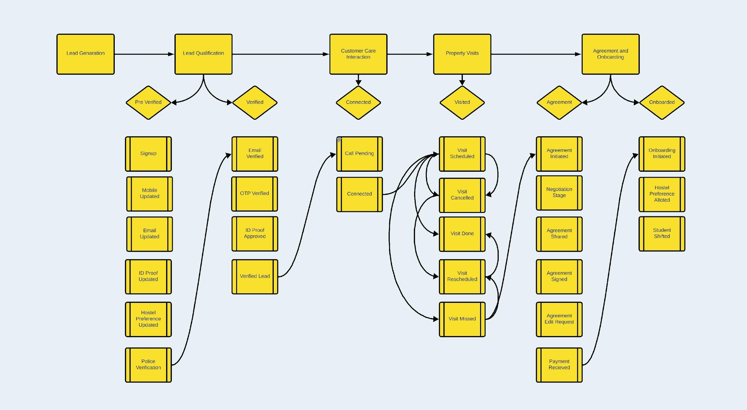
Sales Funnel Flow

Slide 3
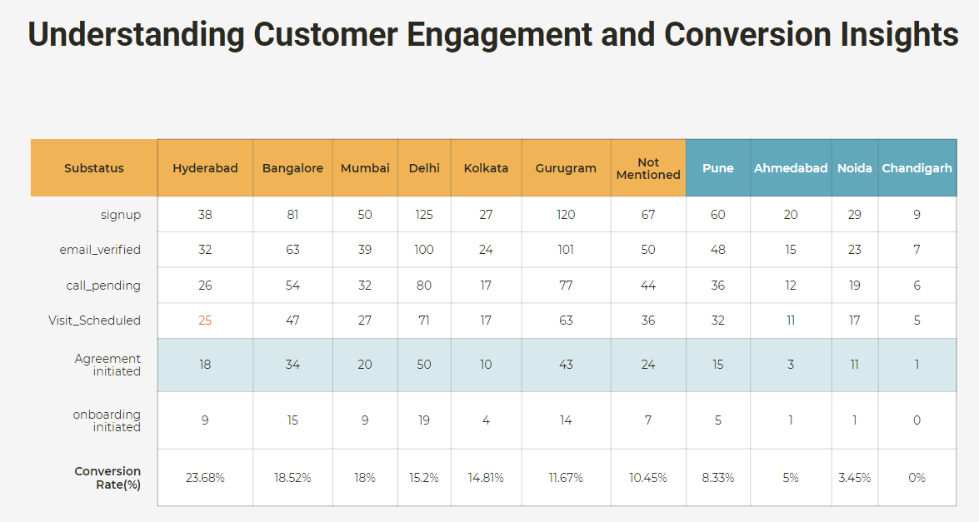

Slide 4
Funnel Analysis and Recommendations
Lets start by examining the data from each stage of the lead conversion process across cities before we dive into areas of improvement. This analysis will provide insights, into areas that require attention.
Moving from the Pre stage to Verified the conversion rates vary among cities. Gurugram and Delhi demonstrate conversion rates while Ahmedabad and Chandigarh lag behind. To enhance this stage it is important to focus on improving the verification process in cities with conversion rates.
When it comes to transitioning from Verified to Visited, Gurugram and Hyderabad exhibit the conversion rates whereas Kolkata and Ahmedabad have room for improvement. Employing communication and implementing engagement strategies can help boost conversion rates in these areas.
In terms of progressing from Visited to Agreement there are disparities between cities. Hyderabad and Gurugram lead in this stage while Chandigarh falls behind. Complex documentation requirements and legal compliance issues may be causing bottlenecks in cities with conversion rates.
Moving forward from Agreement to Connected, Gurugram, Delhi and Hyderabad show conversion rates compared to Kolkata and Ahmedabad which face challenges in this phase. Addressing any bottlenecks that arise during the Agreement stage is crucial for a transition into the stage.
Lastly transitioning from Connected to Onboarded presents challenges across cities, with conversion rates observed. Closing the divide can be accomplished by implementing strategies that're effective, in providing follow up and assistance.

Slide 5
Potential Bottlenecks in the Agreement Process
The Agreement stage is pivotal in the lead conversion process. However, there are potential bottlenecks that can hinder the smooth progression of leads:
Complex Documentation: Lengthy, complex contracts with legal jargon can overwhelm leads, causing them to abandon the process. Simplify agreements using plain language and clear explanations.
Delay in Communication: Slow response times to lead queries can result in frustration and lead abandonment. Implement prompt communication systems and automated responses.
Lack of Personalization: Generic agreements may deter leads. Customize agreements based on each lead's specific needs and preferences.
Inadequate Sales Training: Sales teams not trained to handle the agreement process might struggle to explain terms effectively. Continuous training ensures confident sales representatives.
Technical Issues: Glitches with digital signature platforms or document upload errors can halt the process. Regularly test and update digital signature systems and provide troubleshooting guides.
Lack of Follow-Up: Leads stuck in the agreement process without follow-up can drop off. Implement lead tracking systems for timely follow-up.
Legal Compliance: Ensuring agreements meet legal requirements in different regions can be challenging. Work with legal experts to create standardized, region-specific agreement templates

Slide 6
Recommendations and Strategies
To improve conversion rates and alleviate bottlenecks:
Implement personalized communication strategies.
Provide comprehensive training to the sales team.
Ensure prompt response to lead queries.
Simplify documentation and agreements.
Invest in a robust digital signature platform.
Establish lead tracking systems.
Develop region-specific, legally compliant agreement templates.
Conclusion
By addressing these potential bottlenecks and implementing the recommended strategies, SAPL can create a more efficient lead conversion process, ultimately resulting in higher overall conversion rates and smoother transitions to the onboarding stage across all cities.

